Slide 1
Preliminary Design – Battery Monitor IC & Microcontroller Interface
Owen Santoso (22466085), Project Administrator - Risk
ELEC5552 - Team 06, 31/08/2022

Slide 2
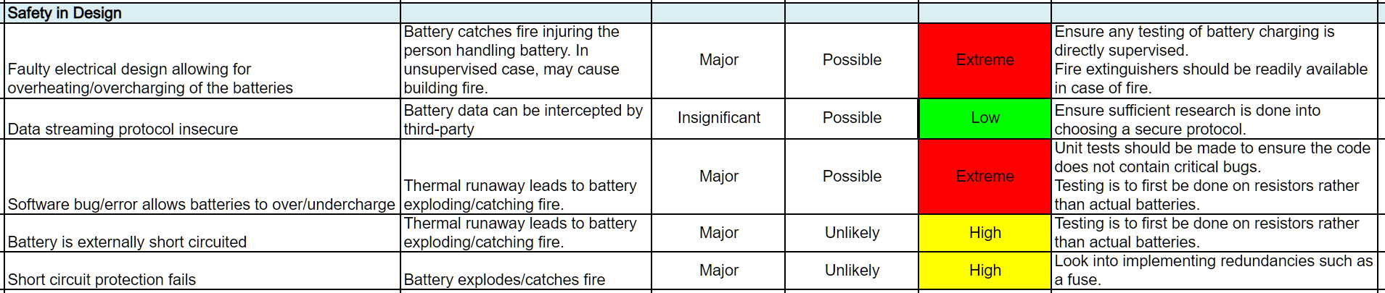
Role & Responsibilities
Project Administrator – Risk
Create and maintain Risk Register (D22#00006R1)
Update with any risks that the team identifies during the project
Requirements Analysis
Contributed to Executive Summary, State of Charge Literature Review section, Adding requirements from information sessions, Proofreading

Slide 3
BQ76942 ↔ Microcontroller Interface

Slide 4
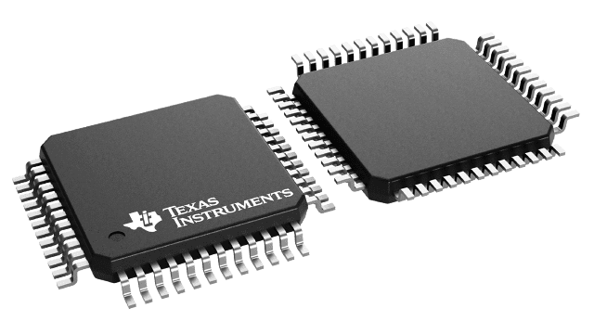
BQ76942 Communication Types
Supports communications options of
I2C
HDQ
SPI
We will use SPI to keep consistent with primary-secondary board communication type

Slide 5
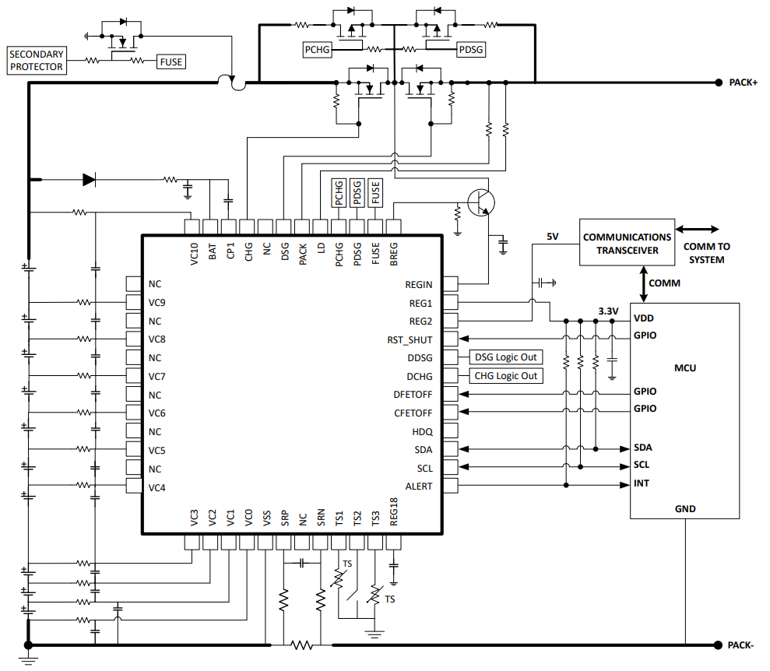
BQ76942 ←→ Microcontroller

Slide 6
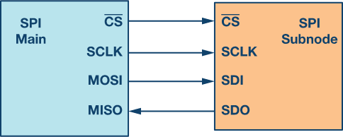
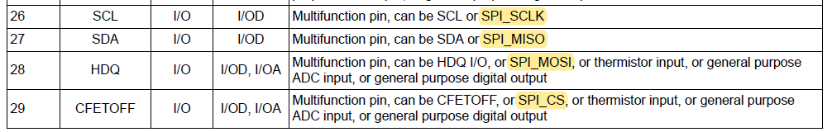

BQ76942 ←→ Microcontroller
BQ76942
Subnode
$$\overline{CS}$$
$$MOSI$$
$$MISO$$
$SCL$K
Main

Slide 7
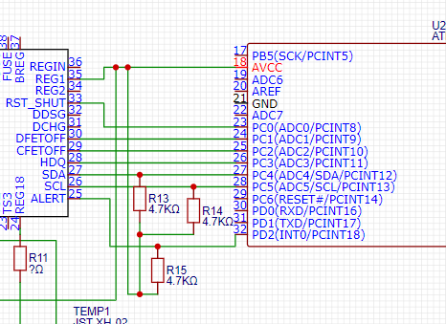

BQ76942 ←→ Microcontroller
BQ76942
Subnode
$$\overline{CS}$$
$$MOSI$$
$$MISO$$
$$SCLK$$
$$\overline{CS}$$
$$MOSI$$
$$MISO$$
$SCL$K
Main

Slide 8
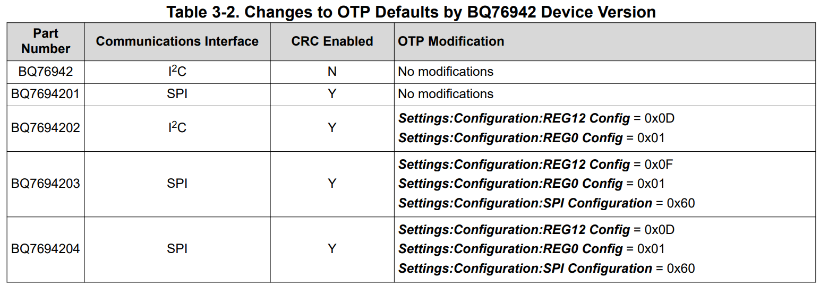
Default Communication Configuration
BQ76942 defaults to either I2C or SPI depending on version
Need to check what version when we order
Need to change
config
✓
✓
✓

Slide 9
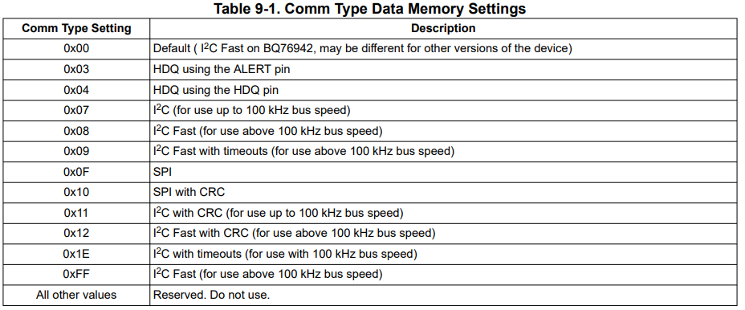
Changing Communications Type
The Settings:Configuration:Comm Type register determines the communication type
‘Default’ may be different depending on device version
We will set this register to 0x10 for SPI with CRC for error detection (ENV_6)

Slide 10
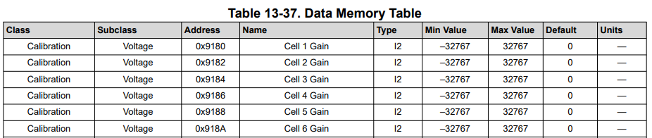
Register Addresses
Register addresses can be found from the Data Memory Table in pg. 196 of Technical Reference Manual
Address of Comm Type register is 0x9239
…

Slide 11
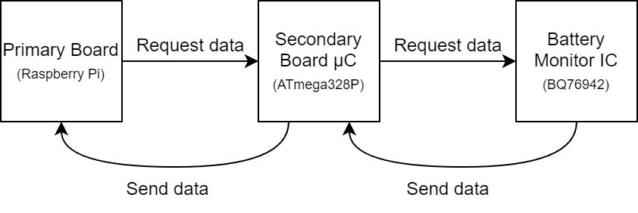
Data Collection
Primary board will request data every 1 second to secondary board microcontroller
Microcontroller will request data from the BQ76942 IC when it receives primary board request
BQ76942 will send the data to the microcontroller
Microcontroller will send this data back to the primary board using the daisy chain SPI communication

Slide 12
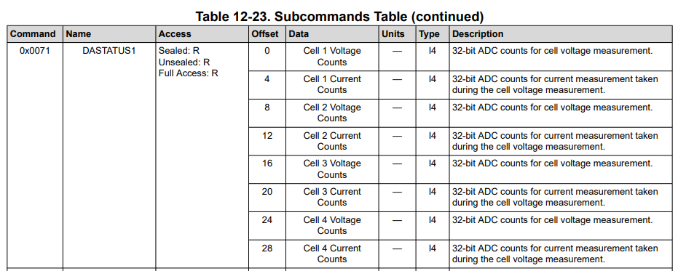
Subcommands
BQ76942 supports subcommands, which are 2 bytes rather than normal 1 byte commands
Can query multiple data values from the chip in one subcommand, rather than sending multiple commands
Subcommands table found on pg. 110 of Technical Reference Manual

Slide 13
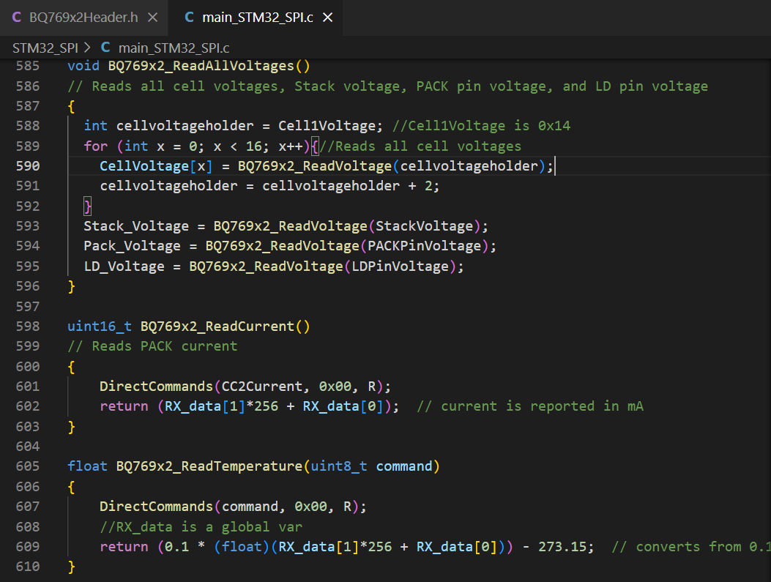
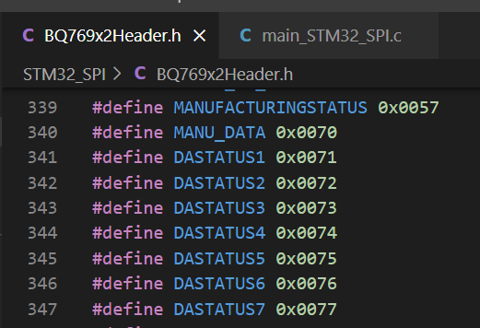
Example Code
Texas Instruments also provides example code on their website for both I2C and SPI communication types
Includes header files which define many of the addresses required

Slide 14
Questions

